Slide 1
Topics to be covered
Telemetry
IoT Telemetry Protocols
Logistics
Cellular IoT
IoT Verticals

Slide 2
Telemetry
Data collected by the device is called telemetry. This is the eyes-and-ears data that IoT devices provide to applications. Telemetry is read-only data about the environment, usually collected through sensors.

Slide 3
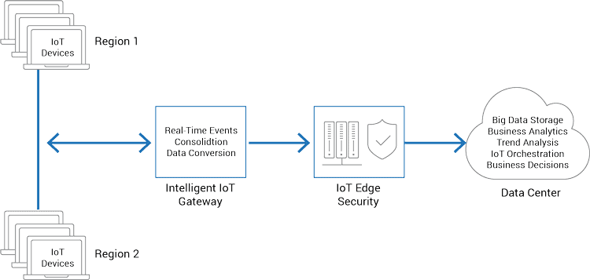
IoT Telemetry Architecture:

Slide 4
IoT Telemetry Protocols
MQTT
SMQTT
CoAP

Slide 5
Logistics
Goals for IoT technology for the Logistics Industry
How the IoT is improving the transportation industry
IoT logistics use cases

Slide 6
Goals for IoT technology for the Logistics Industry:
Improved Security & Theft Detection
Higher Employee Safety
End-to-end product tracking
Providing Business managers with advance analytics
Improving Delivery

Slide 7
How the IoT is improving the transportation industry:
Reliable Vehicle Tracking
Reducing shipping cost
Improve Supply chain planning
Employee Monitoring
Preventing product theft and monitoring transportation conditions

Slide 8
IoT logistics Applications:
Inventory Tracking System
Predictive Analytics System
Location Management Tools
Drone Based Delivery
Automated vehicles

Slide 9
Cellular IoT:
Cellular IoT is a way of connecting physical things (like sensors) to the internet by having them piggyback on the same mobile networks as smartphones.

Slide 10
Two key form of Cellular IoT:
LTE-M
NB-IoT

Slide 11
IoT Verticals:
Smart Systems
Smart Buildings
Industrial IoT
Transportation & Logistics
Smart Agriculture
Smart Home
Smart Cities
Connected Healthcare

Slide 12
1. Smart System
Integrate
Automate
Communicate
Mobile first

Slide 13
2. Smart Building
Energy Efficiency
Environmental Friendly
Operational Efficiency
Improved Security

Slide 14
3. Industrial IoT
Minimize Human Error
Ease of Adoption
Lower Production Costs
Make Better Decisions
Optimize Performance
Reporting

Slide 15
4. Transportation & Logistics
End to end visibility
Data from different sources
Planning
Reporting
Cost Optimization
Service improvement
Real time traceability

Slide 16
5. Smart Agriculture
Complete Visualizations of Operations
Make Better Decisions
Find Correlations
Reporting
Events & Notifications
Lower Cost

Slide 17
6. Smart Homes
Increase Security
Energy Conservation
Automation
Home Assistance
E-Health
Remote Monitoring

Slide 18
7. Smart Cities
Remote Monitoring
Optimize Urban Development
Engage Citizen
Smart Living
Smart Citizen integration

Slide 19
8. Connected Healthcare
Aggregate data from disparate source & systems
Enable real time insights into patient critical care metrics for doctors
Full system transparency

